Slide 1
Owl-iView
Group 1

Slide 2
Owl-iView
Daniel Gross (Product Owner)
Milestones and Front End Development and PowerPoint Presentation
Austin Newland (Scrum Master)
Trello Management and Frontend Development and PowerPoint Presentation
Filipe Catarcione (Lead Developer)
Front and Backend Development and PowerPoint Presentation
Jonathan Ortiz Collazo (Developer)
Front and Backend Development and PowerPoint Presentation
http://owl-iview.azurewebsites.net/
Username = guest@mail.com Password = Guest1234 (Case sensitive)

Slide 3
Purpose
The purpose of this application is to improve the quality of life for Universities by having a real time reporting application to report events and issues on campus.

Slide 4
Motivation
This application allows for real time reports on the university campus to report events and issues. Thus, creating a better quality of life for people on campus.

Slide 5
Target Audience
University Students, Faculty, and Staff.

Slide 6
Functionalities
Ability to upload an image and assign a severity to a post.
Member account management members to edit their profile picture, email, phone number, password, or setup multi factor authentication.
Forgot password link for members to reset their credentials.
Setup remember this computer option on login page.
Allow admins/managers to view/manage a table of all registered users.
Allow members to specify a campus on the post.
Mobile friendly.
Register as a member.
Create a post for an issue /event.
Comment (issue/ event).
Edit/Delete post.
Counter for number of events/issues.
Database to store application information.
Pop-up confirmation dialog box upon deletion to prevent a potential loss of data.
Allow admins/managers to modify the status of an issue.

Slide 7
System Implementation
Languages= C#, HTML, Razor, SQL
Database= SQL Server (Visual Studios)
Framework= We are using Entity Framework with a Code-First approach to work with the database. Entity Framework is an object-relational mapper that enables us to work with relational data using domain-specific objects. It eliminates the need for most of the data-access code that you would need to write. We focus on the domain of our application and start creating classes our domain entity. The Entity Framework API will create the database based on our domain classes.
Platform= ASP.net core (Visual Studios) (Windows, Linux, MAC, Mobile)

Slide 8
Non-functional requirements
System performance and speed will be an advantage with asp.net core. Storage will be on an Azure server. System usability is limited reports cannot be exported. The web system protects user accounts by a password. System accessibility is great with cross platform capabilities. By using the Azure services, we can expect a heavy load of data easily.

Slide 9
Database
The database is primarily managed by several controllers which can be viewed on our team github.
These databases are managed in C# using different classes and async modifier Task
For each Post there are several tables that are kept
Status - tracks the status of each post as a 0, 1, or 2 representing _, _, or _ respectively
Members - Keeps track of the personal information of each user
Post - Keeps track of all information related to each post, including post id, Post title, description, creation date, and url
Comment - Keeps track of each element's id, what is posted in the comment, creation date, and where each comment was posted too
Campus - Keeps track of the Id, name, address and phone number of each campus
Notes:
There is probably a better title for this slide, backend maybe? I don’t know.

Slide 10
Implemented Features
Ability to view and delete and edit a feature
Post service class and Post model class
Issue and Events page
Ability to create, edit, and delete post
Ability to add comments to post
Ability to add details to page
Ability to an an Issue or event
Ability to delete post and comments
About web page on the app
Ability to Upload an image when creating a post
Each Post has a status field
Authentication on post and log-in
Registration page exist and is default page
Campus table in database
Admins and Managers can modify status of issues
Admins can view tables of members
Intro Video to app

Slide 11
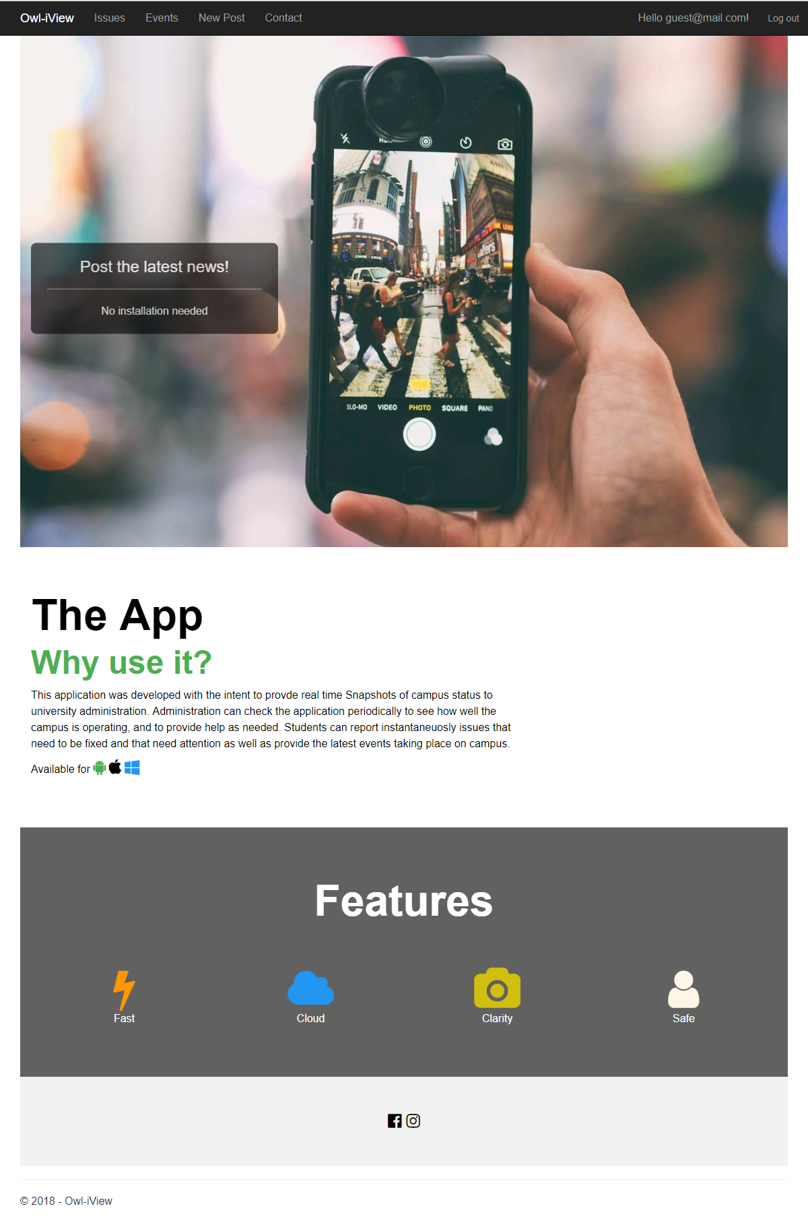
Landing Page
Log-in
Allows the user to log back into account to use the app
Register
Brings the User to the Account register page where they may create an account
Contact
Brings the user to the contact page, where they may find contact information for the application managers

Slide 12
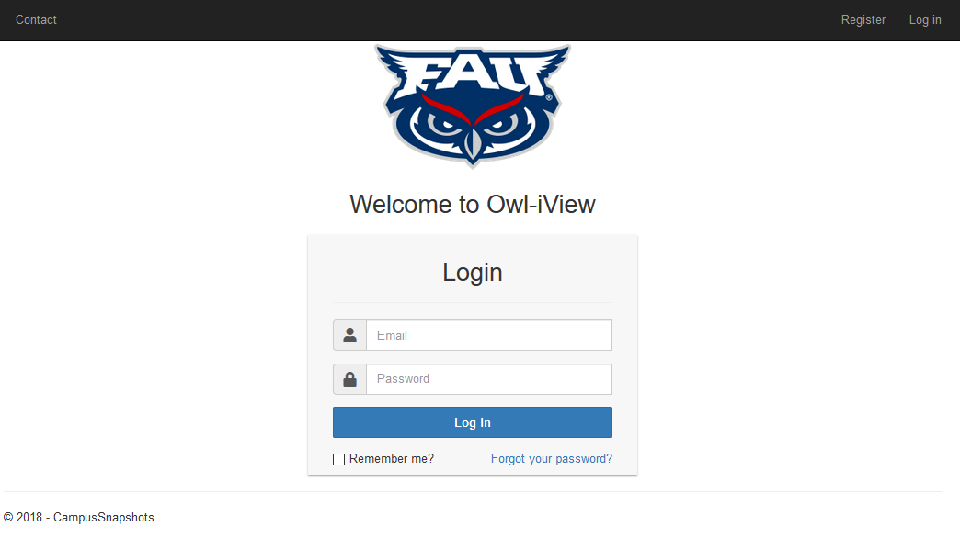
Main Page
Log-in
Allows the user to log back into account to use the app
Register
Brings the User to the Account register page where they may create an account
Contact
Brings the user to the contact page, where they may find contact information for the application managers
Remember me
Remembers which user is logged in so they will not need to re-enter credentials on a revisit
Forgot your password
Brings the user to the ‘Forgot Your Password’ page where they may enter there email to have a link that will let the user reset their password

Slide 13
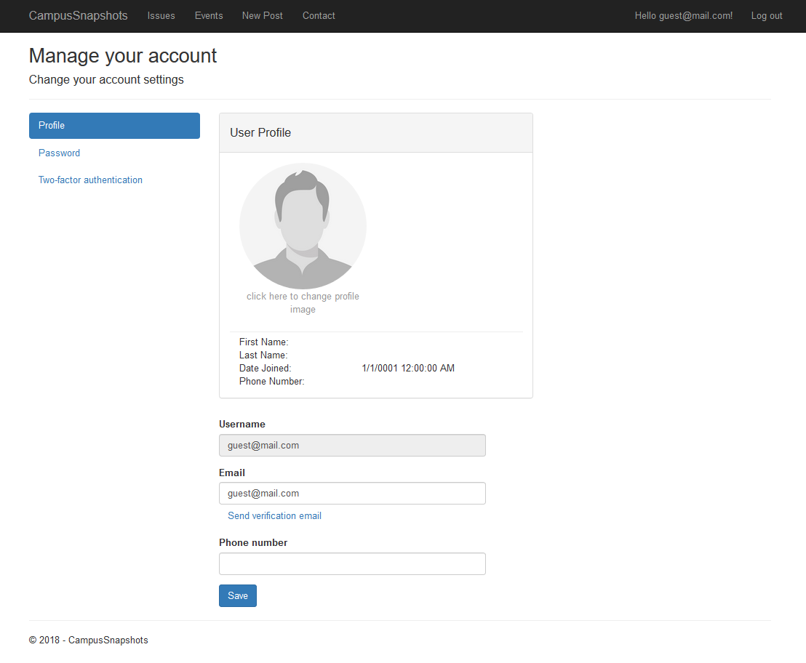
Account Information
Allows the User to manage account information
This includes both personal data and account specific data
Firstname, Lastname, Date Joined, password, email, and phone number
Changing the Password brings the user to a sub-page that requires verification of their current password before adding a new one
Current Password - Verify that the user is who they are by requiring the use of their current password
New Password - Allows the user to set their new password
Confirm New Password - Requires the user to retype their password to prove there is no error
Two-Factor Authentication uses _ to verify that the user is the one logging in or managing their account
*Example Account: Guest, using default picture

Slide 14
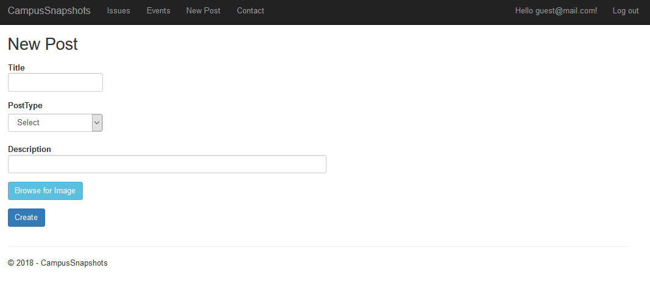
New Post
Title
Title sets the title for the new post the user will make
Post Type
Post type can either be set to Event or Issue
The post type dictates under which section the new post will be placed
Description
Description sets the description for the new post. This can be used to tell what sort of event or issue the post is about as well as things such as the location, time, or important details

Slide 15
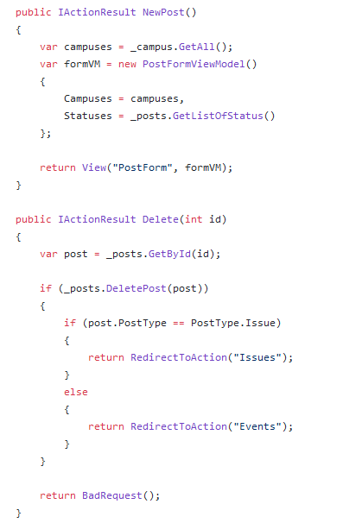
New Post and managing the Database
When a new post is created the function NewPost() is called
Newpost retrieves the data currently in the database as a copy variable, campuses
Following this it creates a new variable in the database ‘formVM’
The post then has it’s status filled and the information is returned with the function call View()
When a post is deleted the function Delete() is called
The function starts by finding the current post with the function GetById()
Following this the function finds if it an an event or issue and removes it off the list respectively
If the function cannot find the post by the id, or if the function is not labeled as an issue or even the function returns as a bad request error
Notes:
This slide sems a bit unnecessary on its own, in retrospect. Not sure if we should add more slides like it, remove it, or leave it as is.

Slide 16
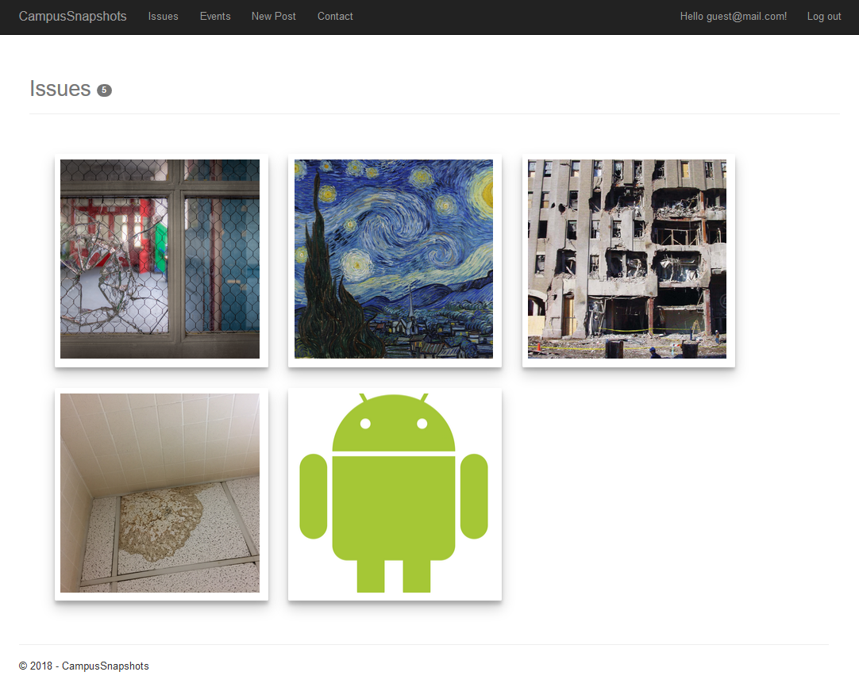
Issues
Allows the User to patrol through various reported Issues and view the Issue’s image.
Issues are displayed based on the time they were created
Clicking on the Issue will bring up the Issue page which will display more information.
At the top the User can also see the amount of Issues currently being listed

Slide 17
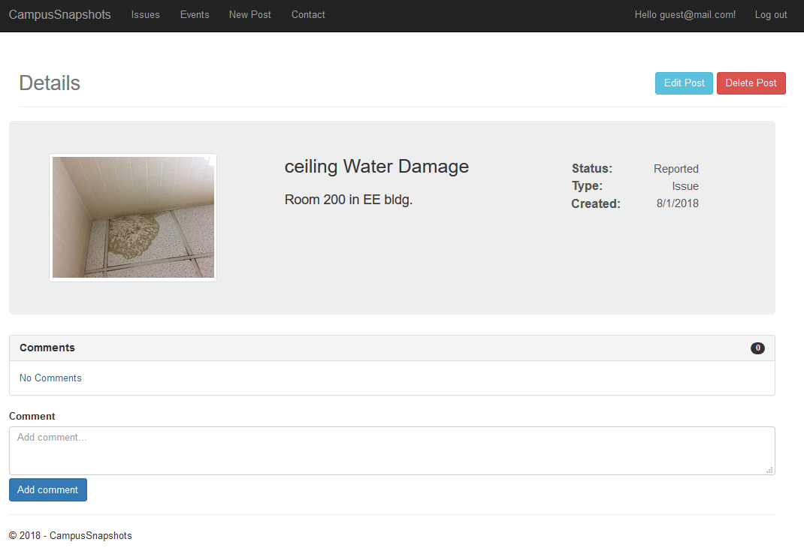
Issue Details
Shows more details on the issue
Issue title
Issue Description
Issue status
Issue creation date
Comment section allows for the user to leave comments on the issue
Comments can be used to give more information, ask questions, or tell others the user’s opinion on the issue
The User may delete comments they posted using the small trash can on the right side of the post
The number of comments is displayed at the top of the comment section, on the grey button
*Example Issue: ceiling Water Damage

Slide 18
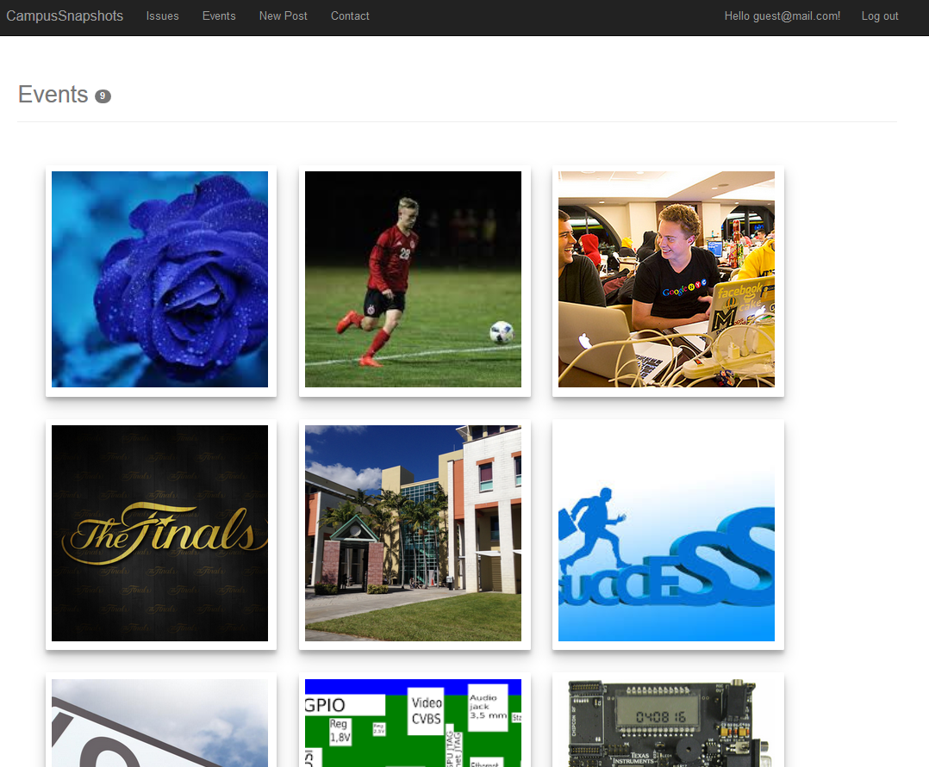
Events
Allows the User to patrol through various reported events and view the event’s image.
Events are displayed based on the time they were created
Clicking on the event will bring up the event page which will display more information.
At the top the User can also see the amount of events currently being listed

Slide 19
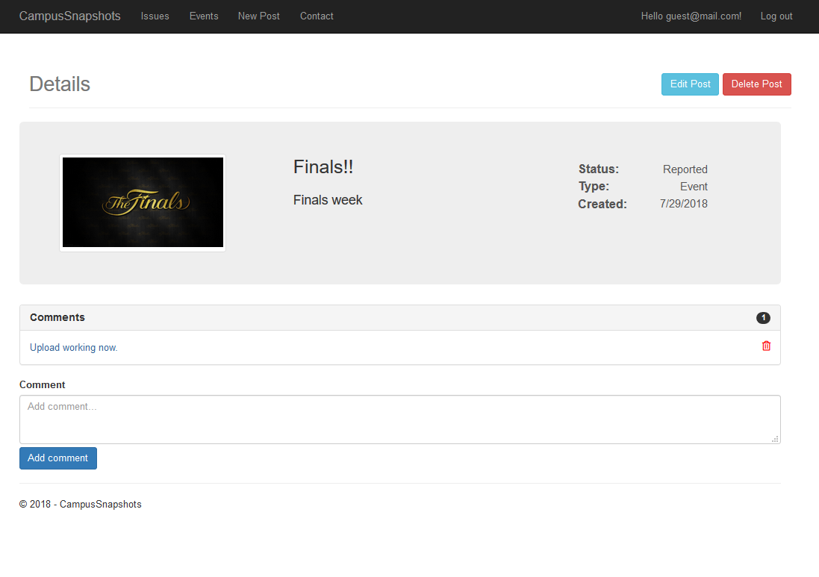
Event Details
Shows more details on the event
Event title
Event Description
Event status
Event creation date
Comment section allows for the user to leave comments on the event
Comments can be used to give more information, ask questions, or tell others the user’s opinion on the event
The User may delete comments they posted using the small trash can on the right side of the post
The number of comments is displayed at the top of the comment section, on the grey button
*Example event: Finals!!

Slide 20
Knowledge Gained
The process of working with the team and building an entire application from beginning to end was great because it gave a real world view into development process. We learned how to build the application with Trello for managing tasks and Github to collaborate with the team for code repository. Also, helped to practice communicating online with for meetings.

Slide 21
Unimplemented features
“Reported by” field for issue post
Authorization requirements for deleting and editing both post and comments.
Could not be implemented without “reported by” field
Post history table for each user
Could not be implemented without “reported by” field
Displayed image selected for new post in the “New Post” page
Allow users to mark their location when creating post.
Add graph to display app daily usage statistics
Add Calendar view for events
Allow the app to display Username next to comments
Add pagination for the issues, events, and member view page
Ability to change or delete photo in a post

Slide 22
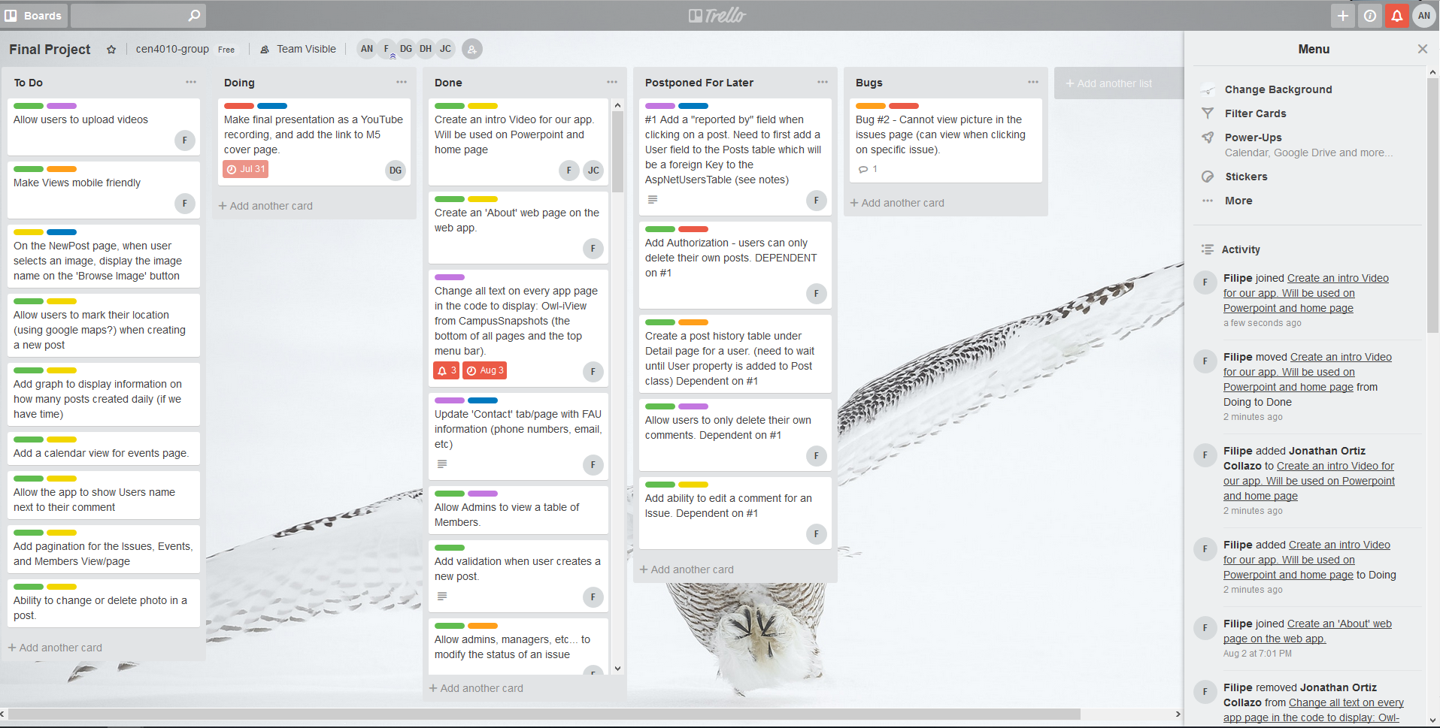
Trello

Slide 23

Notes:
I removed the heading to make the transition to this slide a little more pleasing when it’s ran.

